Slide 1
GEOG0125
Advanced Topics in Social and Geographic Data Science
Introduction to Bayesian inference
Dr Anwar Musah (a.musah@ucl.ac.uk)
Lecturer in Social and Geographic Data Science
UCL Geography
1

Slide 2
About the course
2
Notes:
But before we start, let’s talk about the course…

Slide 3
Description of the GEOG0125 Course
This module will introduce students to advanced topics and methods that are essential for social and geographic data science, i.e., advanced or specialised techniques e.g., applied Bayesian Inference and Machine Learning applied to this domain.
This module covers two areas:
How to use Bayesian Inference for both evidence-based research in making spatial predictions as well as studying the associations between social-risk factors and outcomes
How to use Machine Learning for various image processing and network sciences for tackling future social geographical challenges
3
Notes:
Read the description:
Aims: Unique knowledge on advanced quantitative methods from a statistical and machine learntist point-of-view
Aims: Arm you with knowledge on how to apply 1.) the various families of multivariable models from Bayesian and from Machine learning school of thought
Aims: Expand your technical experience in R and Python programming – In R, you will be learning new interface like Stan or INLA, and Python – packages like Pytorch for deep learning and CNNs

Slide 4
Module Outline & Assessment
Bayesian Statistics | Anwar Musah [AM]
Machine Learning | Stephen Law [SL]
WK01: Introduction to Bayesian Inference [AM]
WK02: Bayesian Generalised Linear Modelling (GLMs) [AM]
WK03: Bayesian Hierarchical Models [AM]
WK04: Spatial Risk Models (Part I) [AM]
WK05: Spatiotemporal Risk Model & Bayesian Updating (Part II) [AM]
WK06: Introduction to Deep Learning [SL]
WK07: Image Analytics [SL]
WK08: Introduction to GeoAI (Part I) [SL]
WK09: Introduction to GeoAI (Part II) [SL]
WK10: Future Outlook and Summary [SL]
All are lecture and teaching materials are posted on external websites to Moodle. Bayesian content is on a dedicated GitBook.
Machine Learning content is hosted on a Jupyter Notebook.
Details about assessment
100% coursework with 2 x reports (each 1,500 words)
1 report focuses uses applied Bayesian methods for spatial analysis.
1 report focuses on Machine Learning for spatial analysis and image classification
4

Slide 5
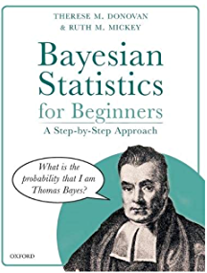
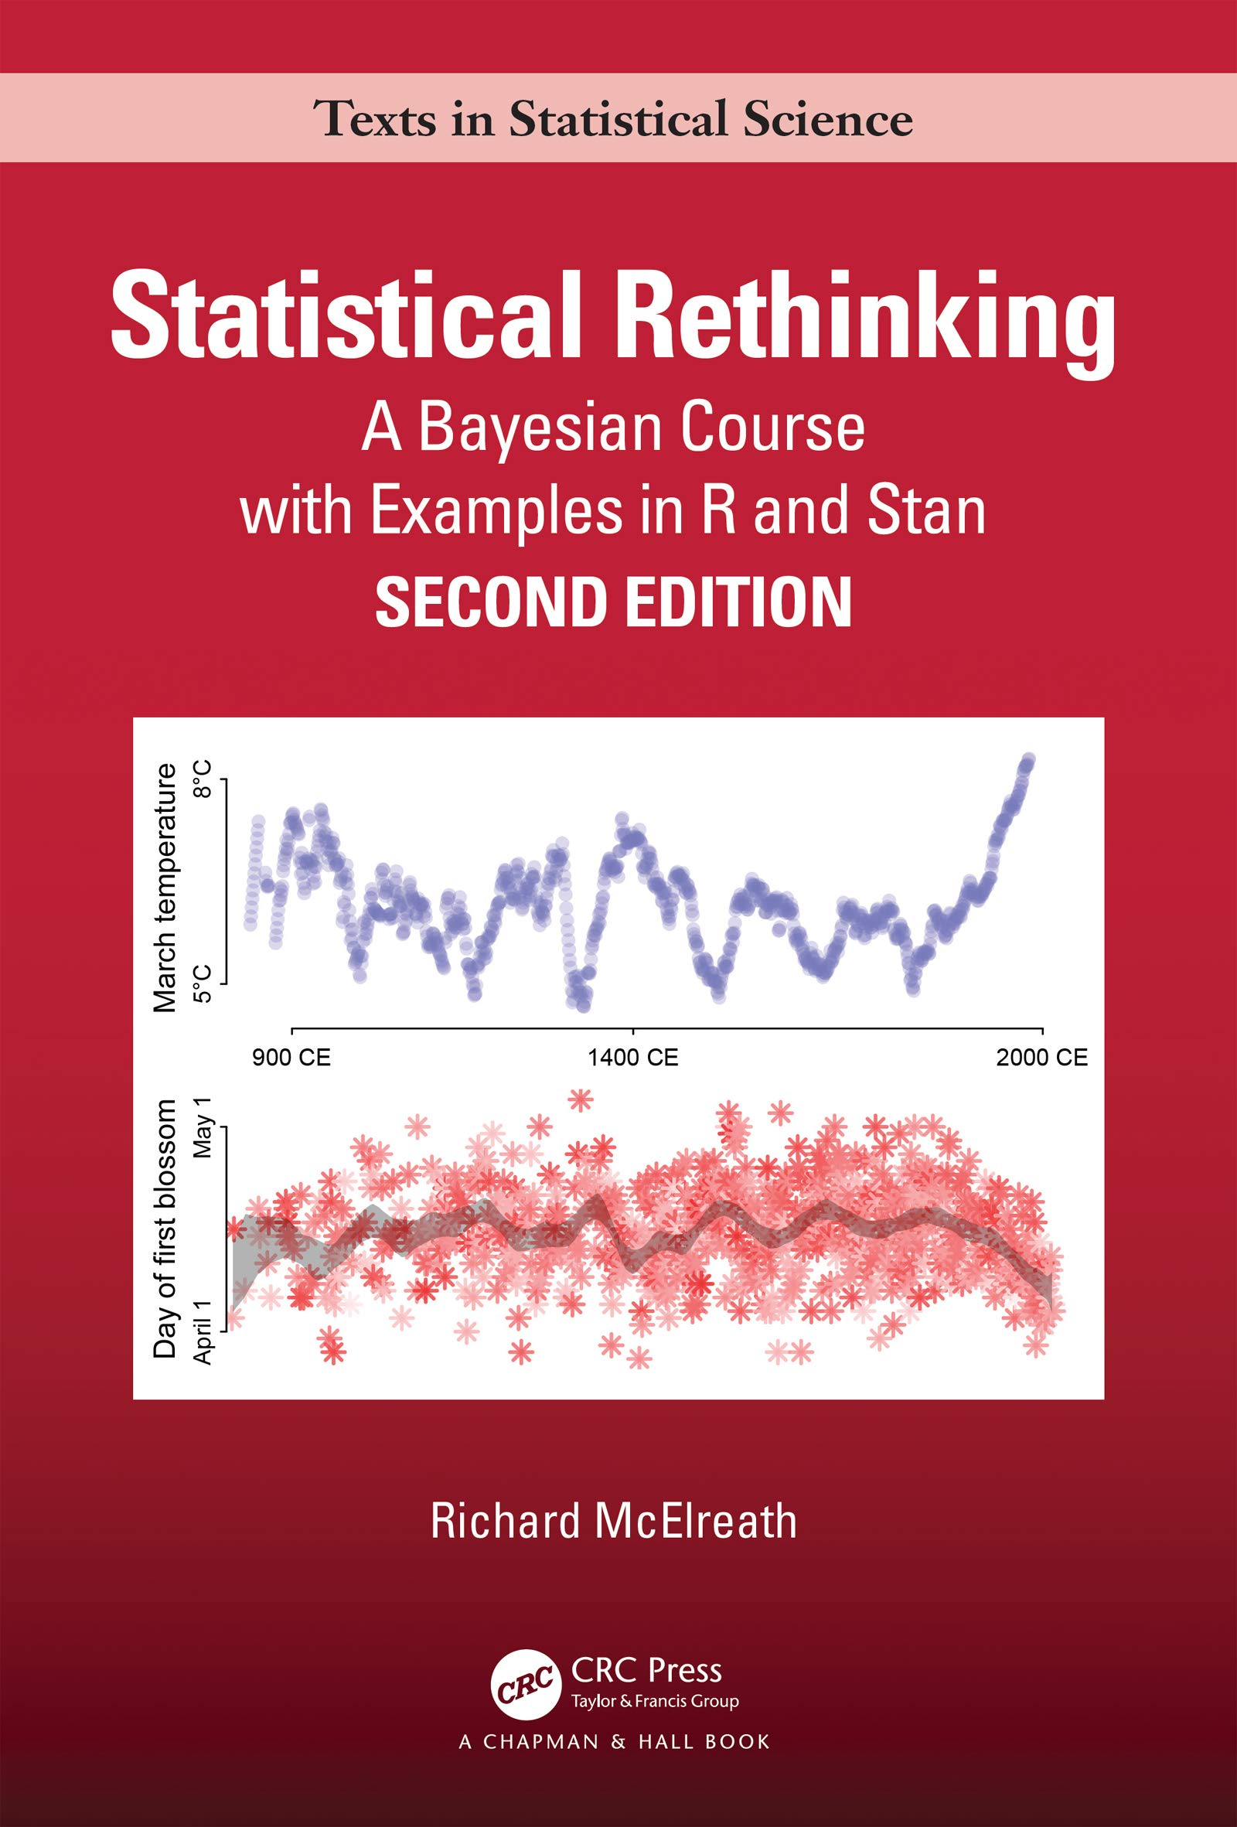

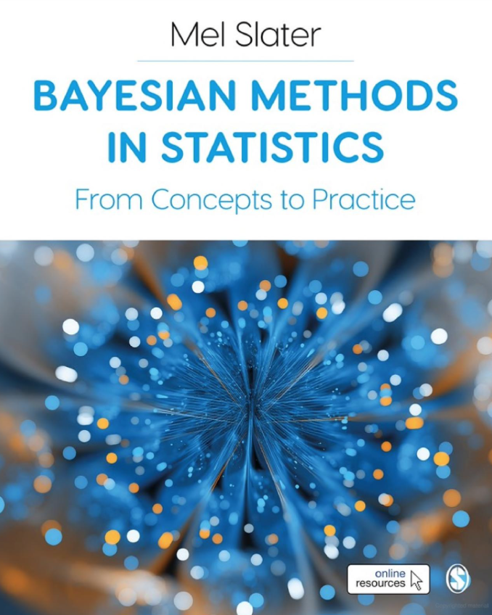
Book recommendations
High recommendation for the mastery of the basic theory and principles of Bayesian Statistics
High recommendation for the coding experience and execution of statistical analysis in RStudio and Stan
5

Slide 6
General format of the course
1-hour lecture
Weekly sessions every Thursday at 10:00am – 11:00am
Delivered by the module tutors
2-hour computer practical seminar
Takes place every Friday 11:00am – 01:00pm
These sessions are facilitated by both the module and seminar tutors
Location(s):
Lectures: 10:00am-11:00am UCL GOSICH’s Wolfson Centre in Room A (Ground Floor)
Computer practicals: 11:00am-01:00pm North-West Wing Building Room G07
Please bring your own laptops to the computer practicals as NWW G07 is not a PC Cluster room
NOTE: All lectures and tutorials sessions are compulsory & will be delivered in-person.
6

Slide 7
Contents
Problem
What is Bayesian Statistics?
What are the types of probabilities?
Bayes’ theorem
What are the various Probability Distributions
The basics of Bayesian Inference
Knowledge
Collect
Model
Wrangle
Explore
7

Slide 8
What is a Bayesian Statistics?
8

Slide 9

Definition:
Bayesian statistics is all about using probability as a tool for quantifying uncertainty in statistical problems.
Probabilities
Probability Distribution
Bayes’ Rule
Bayesian Inference
9
Notes:
Bayesian statistics is a huge area within statistics, and its essentially applied in many fields – in fact, it has a home is social sciences.
Talk about your own experiences, and over the years, what you have realised one needs to understand the subject

Slide 10
What is a Probability?
10
Notes:
Let’s start with unlocking the first padlock – Probabilities 101.
Here, we cover the basic terminology of a probability and learn the three types of probabilities, as these basic building blocks that helps in understanding what the Bayes’ Theorem is, and Probability distributions.
We are going to approach this in a basic way.

Slide 11
Definition:
Probability is the language of uncertainty. It quantifies the uncertainty of a defined event, taking a value between 0 and 1. An event with a probability near zero implies that it is very unlikely to occur, while a probability near one implies that it is very likely.
The usual notation for a probability is: Pr( ) or P( ) or Prob( ) (we will use the notation for Pr( ) throughout this lecture)
A probability, Pr( ) is always defined in relation to an event ‘E’ which has a set number of outcomes. The outcomes are calculated within a sample space (or population size), which is the total number of all possible outcomes that event ‘E’
We can write this and say Pr(E), which is read as “the probability that event E will occur”
Note 1: When we say uncertainty, we are referring to lack of complete sureness (or knowledge) about an event.
Note 2: There are three key terms here, which will be defined in the next slide – An event, an outcome, and a sample space.
11
Notes:
Bayesian Statistics, is basically, all about our attempts to quantify levels of uncertainty using probabilities as a framework.
There are several definitions of probability. The most logical definition of a probability is that it's all about uncertainty.
The key ingredients for calculating a probability is knowing what the event is, the outcome and sample space.
Let’s go through these three terms:-

Slide 12
Basic terminology: event, outcome & sample space [1]
In probability, the following means:
An outcome simply refers to a single result that can emerge from a study.
An event is referred to as the set of outcomes that share a common characteristic in a study.
A sample space is the set of all possible outcomes observed in a study.
Example 1: We are conducting a mosquito infestation survey in 7 households in a village, where a home is either infested or not infested. The dataset collected was as follows = Infested, Not Infested, Not Infested, Not Infested, Infested, Not Infested, Infested
Outcome: Each home “Infested” or ”Not infested” is an individual outcome, so in our dataset, the first entry “Infested” is one outcome and so on.
Event: The event “Infested” consists of all 3 homes (i.e., 1st, 5th and 7th) that are infested i.e., the number of outcomes is 3 infested homes in this event
Suppose the event is “Not infested”, then it will consist of all 4 homes (i.e., 2nd, 3rd, 4th and 6th) that not infested. In this instances, its 4 outcomes in this event.
Sample space: The possible outcomes that can emerge: {Infested, Not infested}
All observed sample space that include 7 outcomes = {Infested, Not Infested, Not Infested, Not Infested, Infested, Not Infested, Infested}
Remember, Pr(E), the probability that an event ‘E’ will occur. This is what the notation for the above example will look like:
The probability that a house is infested with mosquitoes = Pr(Infested)
The probability that a house is not infested with mosquitoes = Pr(Not infested)
12
Notes:
We said that an outcome is a single observation that emerges from a study – In this context…
We said that an event is referred to as the set of outcomes that share a common characteristic in a study.

Slide 13
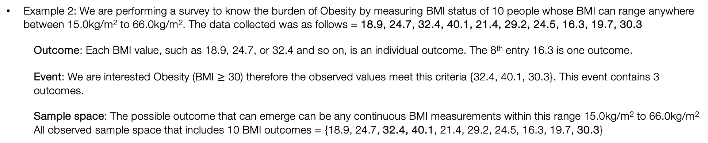
Basic terminology: event, outcome & sample space [2]
In probability, the following means:
An outcome simply refers to a single result that can emerge from a study.
An event is referred to as the set of outcomes that share a common characteristic in a study.
A sample space is the set of all possible outcomes observed in a study.
Example 2: We are performing a survey to know the burden of Obesity by measuring BMI status of 10 people whose BMI can range anywhere between 15.0kg/m² to 66.0kg/m². The data collected was as follows = 18.9, 24.7, 32.4, 40.1, 21.4, 29.2, 24.5, 16.3, 19.7, 30.3
Outcome: Each BMI value, such as 18.9, 24.7, or 32.4 and so on, is an individual outcome. The 8th entry 16.3 is one outcome.
Event: We are interested Obesity (BMI $≥$ 30) therefore the observed values meet this criteria {32.4, 40.1, 30.3}. This event contains 3 outcomes.
Sample space: The possible outcome that can emerge can be any continuous BMI measurements within this range 15.0kg/m² to 66.0kg/m²
All observed sample space that includes 10 BMI outcomes = {18.9, 24.7, 32.4, 40.1, 21.4, 29.2, 24.5, 16.3, 19.7, 30.3}
Remember, Pr(E), the probability that an event ‘E’ will occur. This is what the notation for the above example will look like:
Probability that a person from this cohort is obese = Pr(Obesity)
13

Slide 14
Basic Calculation of a Probability
Example 1: We are conducting a mosquito infestation survey in 7 households in a village. We want to know the probability that a house is infested with mosquitoes:
Event: The event “Infested” consists of all 3 outcomes (i.e., 1st, 5th and 7th home) that are infested
Sample space: All observed 7 outcomes = {Infested, Not Infested, Not Infested, Not Infested, Infested, Not Infested, Infested}
Example 2: We are performing a survey to know the burden of Obesity by measuring BMI status of 10 people. We want to know the probability that a person’s obese:
Event: This event contains 3 outcomes that meet the criteria of obesity status (BMI ≥ 30) i.e., {32.4, 40.1, 30.3}.
Sample space: All observed 10 BMI outcomes = {18.9, 24.7, 32.4, 40.1, 21.4, 29.2, 24.5, 16.3, 19.7, 30.3}
Pr(Infested) = (the number of outcomes in E / total in sample space) = 3/7 = 0.4285 = 42.85%
Pr(Obesity) = (the number of outcomes in E / total in sample space) = 3/10 = 0.30 = 30.00%
The above instance dealing with ‘single events’ are typical examples of an Unconditional Probability.
There are three major types of probabilities: Unconditional, Joint and Conditional probability.
14
Notes:
I am sure you folks are already aware of how to calculate a probability of a single event
Example of calculating a probability
There are three major types of probabilities

Slide 15
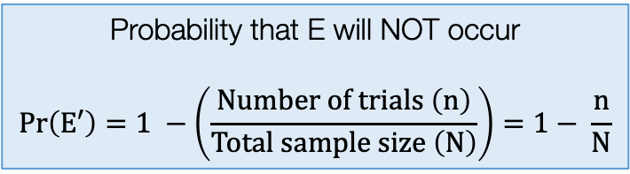
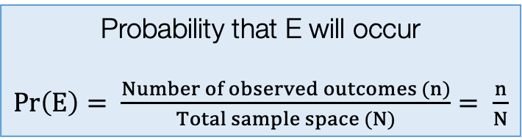
Unconditional Probabilities
An unconditional probability is the chance (or likelihood) that a particular event will occur, without regard to external circumstances such as past, present, or future events.
Usually, the set of outcomes in a single event can be affected by any number of factors; however, with unconditional probabilities, the likelihood of an event ending with a specific results does not account for other conditions that may affect it.
It is also called a Marginal Probability
When there’s data - unconditional (or marginal) probabilities are calculated accordingly as follows:
Probability that E will occur
$Pr\left(E\right)= \frac{Number of observed outcomes (n)}{Total sample space (N)}= \frac{n}{N}$
Probability that E will NOT occur
$$Pr\left(E′\right)=1 −\left(\frac{Number of trials \left(n\right)}{Total sample size \left(N\right)}\right)=1− \frac{n}{N}$$
Note 1: P(E) + P(E’) = 1
Note 2: It is a basic prevalence or proportion value
Note 3: Union (U) is also referred to as the total sample space
We call this complement of E (i.e., E’)
15
Notes:
There are 4 major types of probabilities

Slide 16
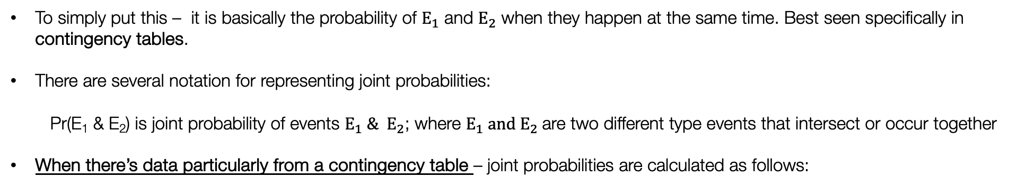
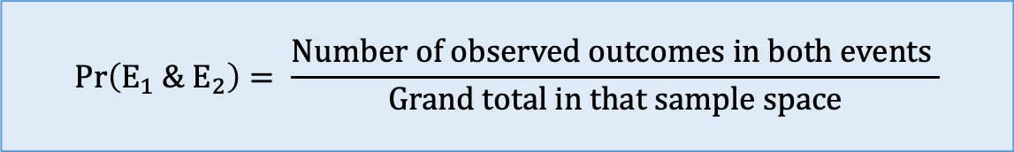
Joint Probabilities
A joint probability refers to the likelihood of more than one event occurring at the same time. For example, if there are two events i.e., $E_{1}$ and $E_{2}$, the joint probability is the chance that both events will occur at the same time.
To simply put this – it is basically the probability of $E_{1}$ and $E_{2}$ when they happen at the same time. Best seen specifically in contingency tables.
There are several notation for representing joint probabilities:
Pr(E₁ & E₂) is joint probability of events $E_{1} \& E_{2}$; where $E_{1} and E_{2}$are two different type events that intersect or occur together
When there’s data particularly from a contingency table – joint probabilities are calculated as follows:
$$Pr\left(E_{1} \&{ E}_{2}\right)= \frac{Number of observed outcomes in both events }{Grand total in that sample space}$$
16
Notes:
Update this formula

Slide 17
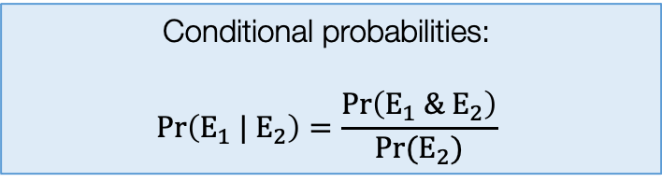
Conditional Probabilities
A conditional probability of an event $E_{1}$is the probability that $E_{1}$ will happen given that the event $E_{2}$ has already occurred.
Simply put – it’s the likelihood of an event E₁ occurring, based on the occurrence of a previous event E₂.
We say: “Probability of ‘this’ given ‘that’” – where the probability of event E₁ depends on the occurrence of event E₂
The notation for representing conditional probabilities using this symbol “|” to represent ‘given’. It is written as: Pr(E₁ | E₂) which means the probability of E₁ given E₂
Conditional probabilities are computed accordingly as follows:
Conditional probabilities:
$$Pr\left(E_{1} |{ E}_{2}\right)=\frac{Pr\left(E_{1} \& E_{2}\right)}{Pr⁡(E_{2})}$$
Notes: Calculating the conditional probabilities
are quite involved. You will need to calculated the
joint probabilities of E1 and E2, and unconditional
probability of E2 and divide them together.
17

Slide 18
Example: Study on measuring abundance of Adult mosquitoes in Location A [1]
 | Breeding sites: Aedes | Breeding sites: No Aedes | Sum (Row)
Urban | 182 | 1008 | 1190
Rural | 132 | 861 | 993
Sum (Column) | 314 | 1869 | Grand total: 2183
We are interested detected presence of adult mosquitoes from breeding sites within an urban or rural setting
Let the B represent the event Breeding sites: Aedes
Let the B’ represent the event Breeding sites: No Aedes
Let the U represent the event urban area (i.e., total number of breeding sites found in an urban setting)
Let the U’ represent the event rural area (i.e., total number of breeding sites found in a rural setting)
Unconditional Probabilities
Joint Probabilities
18
Conditional Probabilities

Slide 19
Example: Study on measuring abundance of Adult mosquitoes in Location A [2]
 | Breeding sites: Aedes | Breeding sites: No Aedes | Sum (Row)
Urban | 182 | 1008 | 1190 (/2183)
Rural | 132 | 861 | 993 (/2183)
Sum (Column) | 314 (/2183) | 1869 (/2183) | Grand total: 2183
Here, we can compute the probabilities by simply dividing the number of events observed by the overall total sample space which is 2183
The second table, we have simply converted the raw values to probabilities. The light blue shaded cells are the unconditional (or marginal) probabilities
 | Breeding sites: Aedes (B) | Breeding sites: No Aedes (B’) | Sum (Row)
Urban (U) |  |  | 0.55 P(U)
Rural (U’) |  |  | 0.45 P(U’)
Sum (Column) | 0.14 P(B) | 0.86 P(B’) | Grand total: 1
Probability of finding breeding site
in Urban location = 0.55
Probability of finding breeding site
in Rural location = 0.45
Unconditional Probabilities
Probability of finding breeding site
with Aedes mosquito = 0.14
Probability of finding breeding site
with no Aedes mosquito = 0.86
19

Slide 20
Example: Study on measuring abundance of Adult mosquitoes in Location A [2]
 | Breeding sites: Aedes | Breeding sites: No Aedes | Sum (Row)
Urban | 182 | 1008 | 1190 (/2183)
Rural | 132 | 861 | 993 (/2183)
Sum (Column) | 314 (/2183) | 1869 (/2183) | Grand total: 2183
 | Breeding sites: Aedes (B) | Breeding sites: No Aedes (B’) | Sum (Row)
Urban (U) | B & U | B’ & U | 0.55 P(U)
Rural (U’) | B & U’ | B’ & U’ | 0.45 P(U’)
Sum (Column) | 0.14 P(B) | 0.86 P(B’) | Grand total: 1
20
Joint Probabilities

Slide 21
Example: Study on measuring abundance of Adult mosquitoes in Location A [3]
 | Breeding sites: Aedes | Breeding sites: No Aedes | Sum (Row)
Urban | 182 (/2183) | 1008 (/2183) | 1190
Rural | 132 (/2183) | 861(/2183) | 993
Sum (Column) | 314 | 1869 | Grand total: 2183
In the second table, we can convert these raw values to joint probabilities. The dark blue shaded cells are the joints probabilities computed by using the formula shown in slide #16
 | Breeding sites: Aedes (B) | Breeding sites: No Aedes (B’) | Sum (Row)
Urban (U) | 0.0834 Pr(B & U) | 0.4617 Pr(B’ & U) | 0.55 Pr(U)
Rural (U’) | 0.0605 Pr(B & U’) | 0.3944 Pr(B’ & U’) | 0.45 Pr(U’)
Sum (Column) | 0.14 Pr(B) | 0.86 Pr(B’) | Grand total: 1
Probability of finding a breeding
site with Aedes mosquitoes in
rural areas = 0.0605 (6.05%)
Probability of finding a breeding
site with no Aedes mosquitoes in
rural areas = 0.3944 (39.44%)
21
Joint Probabilities

Slide 22
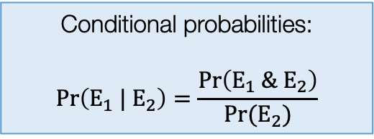
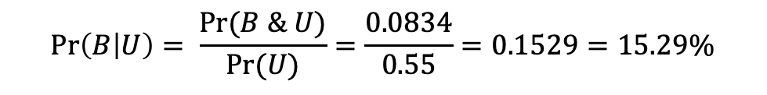
Example: Study on measuring abundance of Adult mosquitoes in Location A [3]
 | Breeding sites: Aedes | Breeding sites: No Aedes | Sum (Row)
Urban | 182 | 1008 | 1190
Rural | 132 | 861 | 993
Sum (Column) | 314 | 1869 | Grand total: 2183
Suppose, we want to know what the probability that that Aedes mosquito are present in breeding sites given the setting is urban i.e., Pr(B|U), a conditional probability.
We will need the joint probability Pr(B & U)
We will need the unconditional probability for Pr(U)
 | Breeding sites: Aedes (B) | Breeding sites: No Aedes (B’) | Sum (Row)
Urban (U) | 0.0834 Pr(B & U) | 0.4617 Pr(B’ & U) | 0.55 Pr(U)
Rural (U’) | 0.0605 Pr(B & U’) | 0.3944 Pr(B’ & U’) | 0.45 Pr(U’)
Sum (Column) | 0.14 Pr(B) | 0.86 Pr(B’) | Grand total: 1
Conditional probabilities:
$$Pr\left(E_{1} |{ E}_{2}\right)=\frac{Pr\left(E_{1} \& E_{2}\right)}{Pr⁡(E_{2})}$$
$$\operatorname{Pr}\left(B | U\right)= \frac{Pr⁡(B \& U)}{Pr⁡(U)}=\frac{0.0834}{0.55}=0.1529=15.29\%$$
22
Conditional Probabilities

Slide 23
Probabilities
Probability Distribution
Bayes’ Rule
Bayesian Inference
23
Notes:
These are the three main types of probabilities one often comes across – and these are typical example of single instance! What is we want to quantify the probability of all possible outcomes – this is where probability distribution comes to play. This is key padlock one must overcome.

Slide 24
Probability Distributions
24

Slide 25
Definition:
Probability distribution is a mathematical function estimates the plausibility of observing a particular value (or range of values) for a variable. It can be used to estimate cumulative probability up to a certain value.
There are broadly two groups for probability distributions with several subtypes:
Probability Mass Function (PMFs) (Discrete)
Discrete uniform distribution
Bernoulli distribution
Binomial distribution
Poisson distribution
Probability Density Function (PDFs) (Continuous)
Uniform distribution
Gaussian (or Normal) distribution
Gamma distribution (flexible)
Beta distribution (flexible)
Note: These distributions can handle variables that counts, or a discrete (or distinct) in nature.
Note: These distributions can handle variables that are continuous in nature
Important note:
In Bayesian inference, probability distributions are applied to the components of Bayes’ rule, including the likelihood function and prior probability, to derive the posterior probability.
We assign a probability distribution to model the plausibility of an outcome (likelihood) and subjectively choose another probability distribution (the prior) to represent our beliefs about the parameters we want to estimate. The prior reflects our assumptions about the plausibility (or shape) of the parameter values before observing the data.
25
Notes:
Let’s illustrate a curve

Slide 26
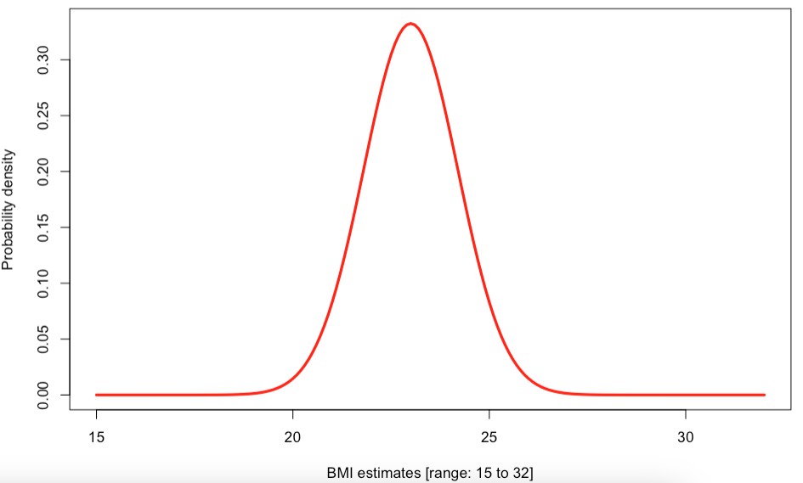
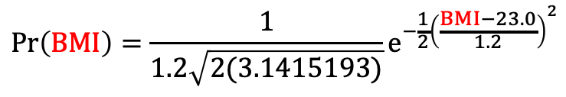
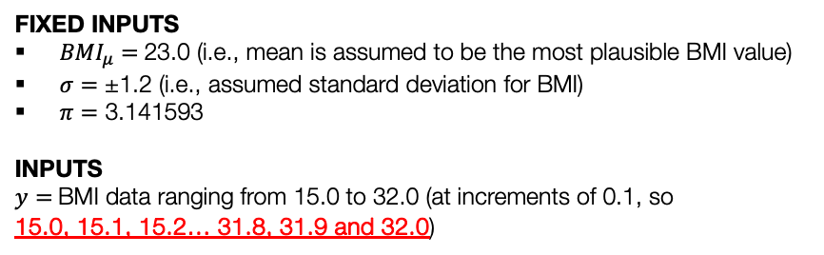
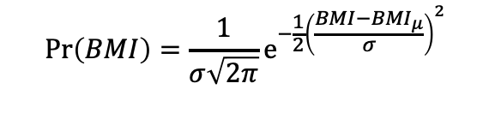

How does Probability Distribution work? [1]
Using a simple probability distribution i.e., Normal Distribution for computing plausibility of an observed value
$$Pr\left(BMI\right)=\frac{1}{σ\sqrt{2π}}e^{−\frac{1}{2}{\left(\frac{BMI−{BMI}_{μ}}{σ}\right)}^{2}}$$
$$⇠⇢norm({BMI}_{μ},σ)$$
FIXED INPUTS
${BMI}_{μ}=$23.0 (i.e., mean is assumed to be the most plausible BMI value)
$σ=$ ±1.2 (i.e., assumed standard deviation for BMI)
$π=$ 3.141593
INPUTS
$y=$BMI data ranging from 15.0 to 32.0 (at increments of 0.1, so
15.0, 15.1, 15.2… 31.8, 31.9 and 32.0)
Each data point is inserted into this formula to get a plausibility value for range of BMI outcomes.
$$Pr\left(BMI\right)=\frac{1}{1.2\sqrt{2(3.1415193)}}e^{−\frac{1}{2}{\left(\frac{BMI−23.0}{1.2}\right)}^{2}}$$
Degree of Plausibility
It generates this curve
For instance, we can estimate how plausible it is for someone have a BMI of exactly 0.2509. This value of 0.2509 represents the likelihood of BMI being 22.1 relative to all other BMI values on the distribution
This is not a probability nor percentage!
22.1
Range of BMI values [15 to 32]
26
Notes:
Suppose you have a population – and you have prior knowledge about their BMI i.e., mean and SD

Slide 27
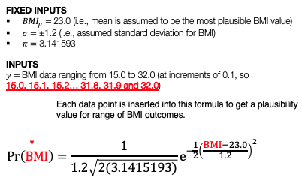
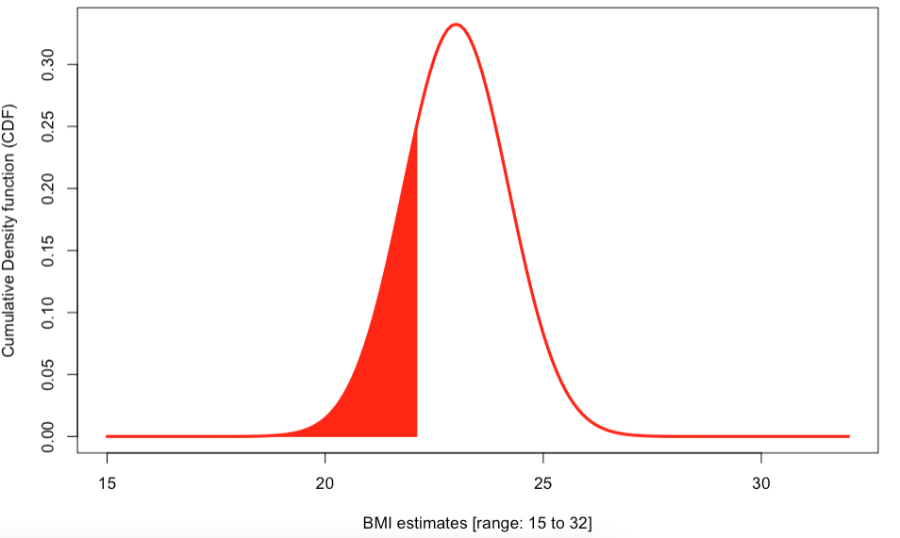
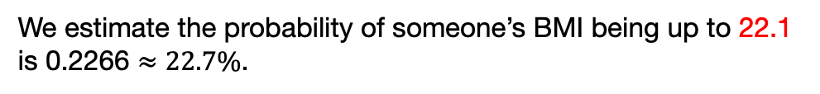
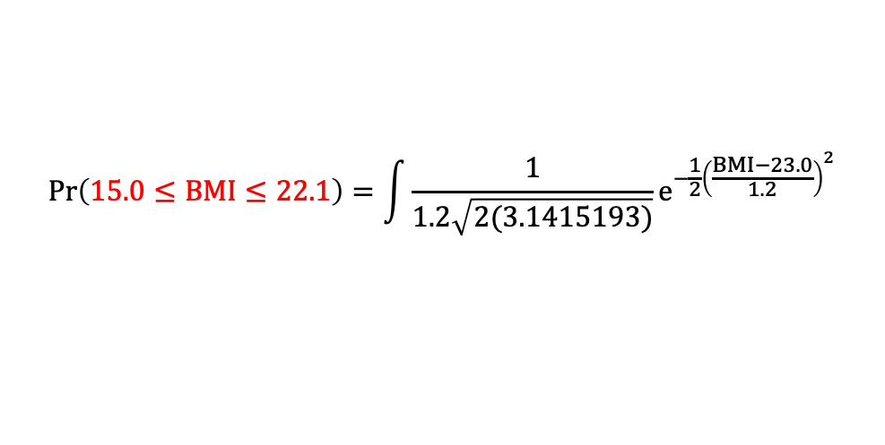
How does Probability Distribution work? [2]
Using a simple probability distribution i.e., Normal Distribution for computing probability of an observed value
$$Pr\left(BMI\right)=\frac{1}{σ\sqrt{2π}}e^{−\frac{1}{2}{\left(\frac{BMI−{BMI}_{μ}}{σ}\right)}^{2}}$$
$$⇠⇢norm({BMI}_{μ},σ)$$
This generates this curve
Degree of Plausibility
Find the area under the curve from this BMI distribution for values up to 22.1 calculates the probability of BMI being a up to a value.
$$Pr\left(15.0≤BMI≤22.1\right)=\int{\frac{1}{1.2\sqrt{2(3.1415193)}}e^{−\frac{1}{2}{\left(\frac{BMI−23.0}{1.2}\right)}^{2}}}$$
22.1
We estimate the probability of someone’s BMI being up to 22.1 is 0.2266 $≈22.7\%$.
Range of BMI values [15 to 32]
27
Notes:
Suppose you have a population – and you have prior knowledge about their BMI i.e., mean and SD

Slide 28
Probabilities
Probability Distribution
Bayes’ Rule
Bayesian Inference
28

Slide 29
Bayes’ Theorem
29

Slide 30
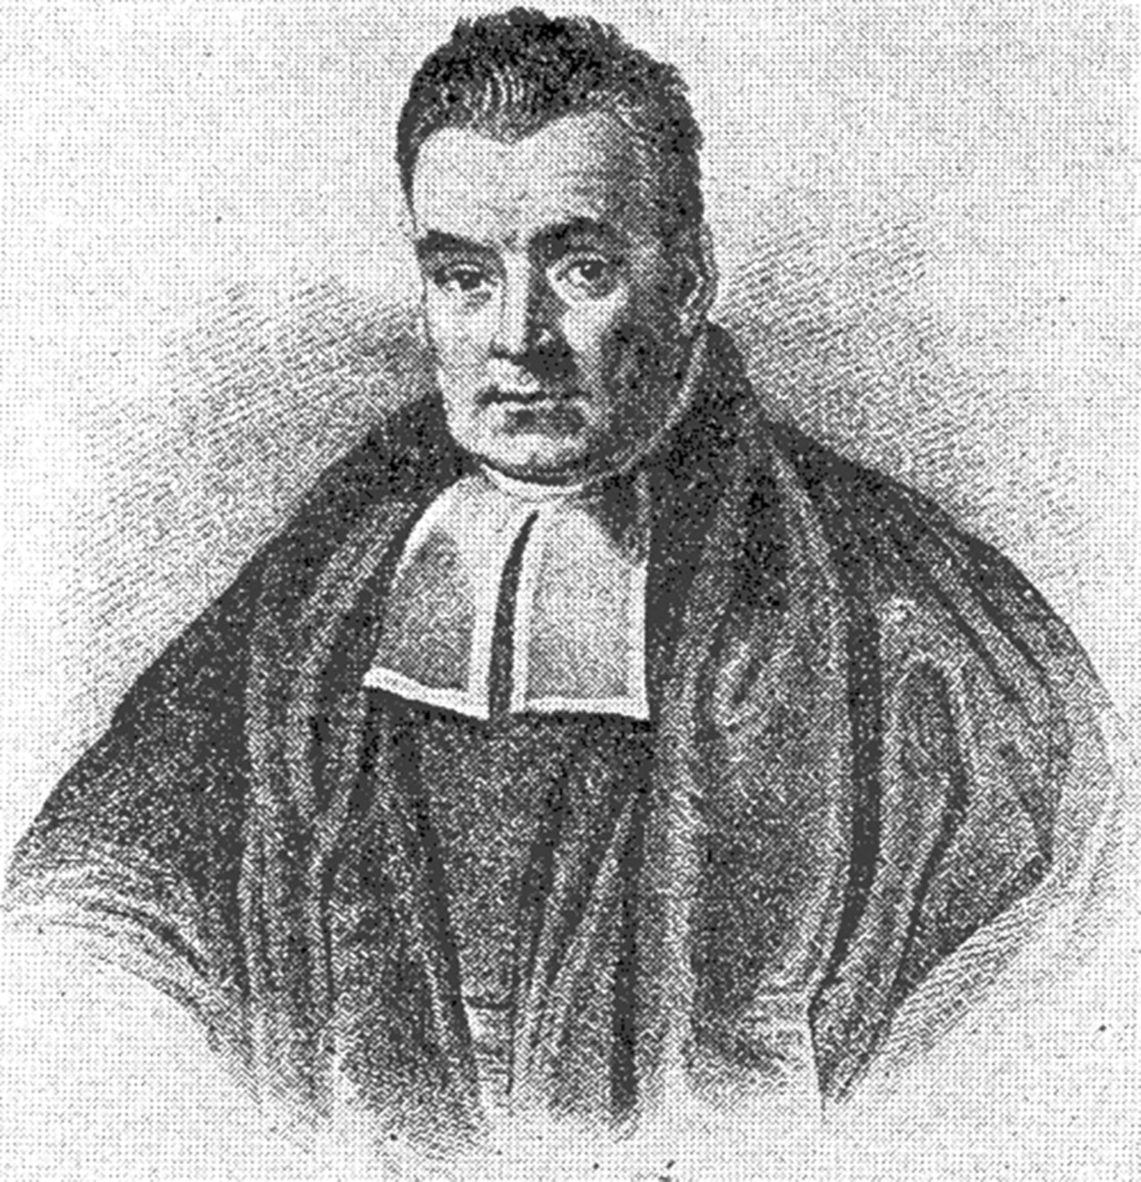

Definition:
Bayes’ theorem (or law) determines the posterior probability of the parameters we estimate given the observed dataset.
It’s a mathematical formula comprise of conditional and marginal probabilities
It expresses how a subjective degree of belief should rationally change to account for new evidence.
The basic formulation for Bayes’ Theorem (or Law):
$$Pr\left(Parameter | Data\right) ∝ Pr\left(Data \right| Parameter) Pr⁡(Parameter)$$
Probability of our new parameter being true after we’ve observed dataset
Plausibility of the observed data we have, given the parameter has a specific value(s)
Our belief about what the parameter is, before observing the data
Thomas Bayes (1701 – 1761)
Posterior probability $∝$ Likelihood x Prior Probability
This equation is the backbone of Bayesian Statistics
30

Slide 31
Selection of priors for Likelihood $P(Y|θ)$ or Priors $P(θ)$
Characteristic | Check shape | Function | Distribution | Statistical Notation | Usage
Continuous measure (scale, interval) | Bell shape (centre, or shifted) | PDF | Gaussian | norm(mu, sigma) | Set it as a likelihood Use as prior
Proportion (with information on the numerator and denominator) | Does not matter | PMF | Binomial | bin(n, p) | Set it as a likelihood (only)
Counts | Does not matter | PMF | Poisson | poisson(rate) | Set it as a likelihood (only)
Binary measure (Yes, No) | Does not matter | PMF | Bernoulli | bern(p) | Set it as a likelihood (only)
Continuous measure (scale, interval) Proportion (with information on the numerator and denominator) Counts | Flat shape | PDF/PMF | Uniform | uniform(a, b) | Use ONLY as a prior Use it if you don’t have any prior information This is an uninformative prior
Continuous measure (scale, interval) Counts | Skewed shape | PDF/PMF | Gamma | Gamma(rate, shape) | Use ONLY as a prior It’s flexible
Proportion (with information on the numerator and denominator) | Does not matter | PDF | Beta | Beta(theta, shape1, shape2) | Use ONLY as a prior It’s flexible
31

Slide 32
Probabilities
Probability Distribution
Bayes’ Rule
Bayesian Inference
32

Slide 33
Bayesian Inference
33

Slide 34
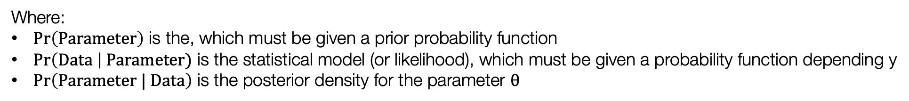
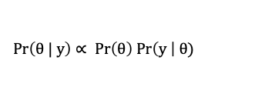
Performing Bayesian Inference
$$Pr\left(θ | y\right)∝ Pr\left(θ\right) Pr\left(y \right| θ)$$
For point or interval estimation of a parameter $θ$, the inference is based off:
$$Pr\left(Parameter | Data\right) ∝ Pr\left(Data \right| Parameter) Pr⁡(Parameter)$$
Posterior probability $∝$ Likelihood x Prior Probability
Where:
$Pr\left(Parameter\right)$ is the, which must be given a prior probability function
$Pr\left(Data \right| Parameter)$ is the statistical model (or likelihood), which must be given a probability function depending y
$Pr\left(Parameter | Data\right)$ is the posterior density for the parameter $θ$
Specifying the likelihood’s probability function is very easy. Often, you will be using normal, Poisson or binomial distribution to deal continuous, counts, or binary outcomes respectively.
The difficulty lies in the specification of the prior probability function. Here its entirely subjective.
34
Notes:
It is common practice to re-wite the Bayesian inference model with the proportional symbol – and

Slide 35
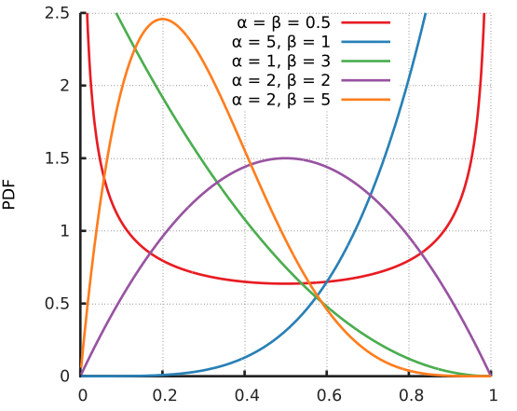
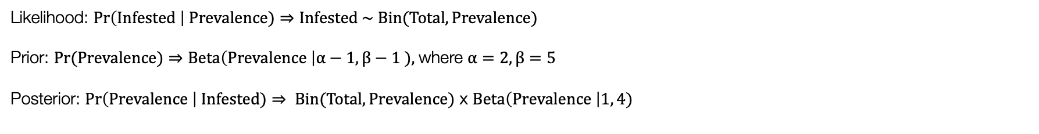
Motivating example
What is the plausible prevalence for infestation in Recife right now?
Last survey year: 09/2024 | Number properties detected with Aedes | Overall number of properties surveyed
* Most recent data collection effort. | 428 | 976
Beta distribution
Important Information:
Number of infested properties (428) [Data]
Total number of properties surveyed (976) [Data]
The prevalence of infestation is unknown, but we want to estimate the plausible value for prevalence of infestation [Parameter]
Prior information for prevalence (i.e., our knowledge or belief) is assumed 0.20 (in most cases, the prevalence from past research around this time is often this value of 20-25%. [Parameter]
Likelihood: $Pr\left(Infested \right| Prevalence)$ $⇒$ $Infested \sim Bin(Total, Prevalence)$
Prior: $Pr(Prevalence)$ $⇒$ $Beta\left(Prevalence \right|α−1, β−1 ),$where $α=2, β=5$
Posterior: $Pr\left(Prevalence \right| Infested)$ $⇒ Bin(Total, Prevalence)$ x $Beta\left(Prevalence \right|1, 4)$
35

Slide 36
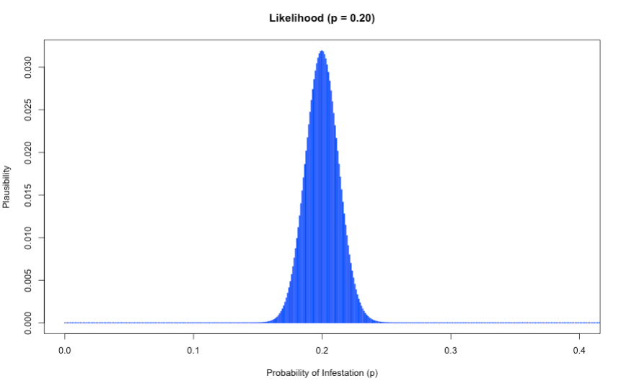
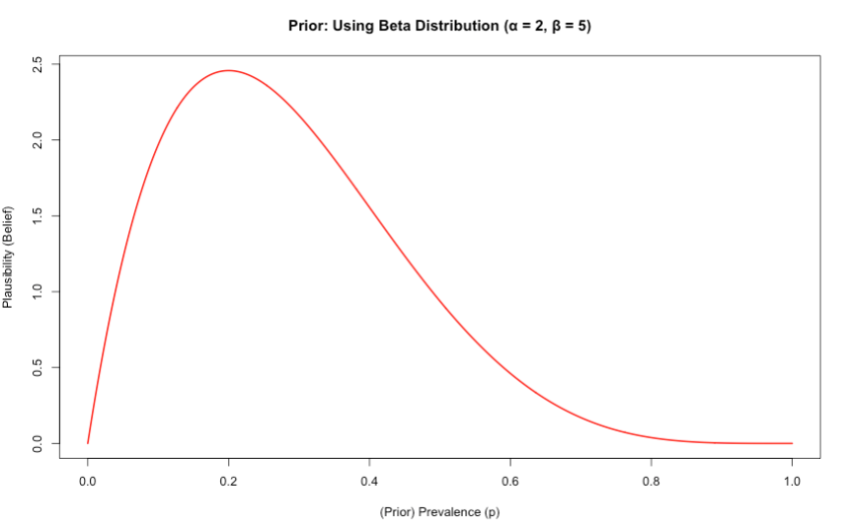
Motivating example (cont.)
$Bin(Total, Prevalence)$ x $Beta\left(Prevalence \right|a − 1, b−1)$
Combining the likelihood function with prior distribution based on our assumptions/knowledge, we get a new posterior distribution with an updated prevalence values

Slide 37
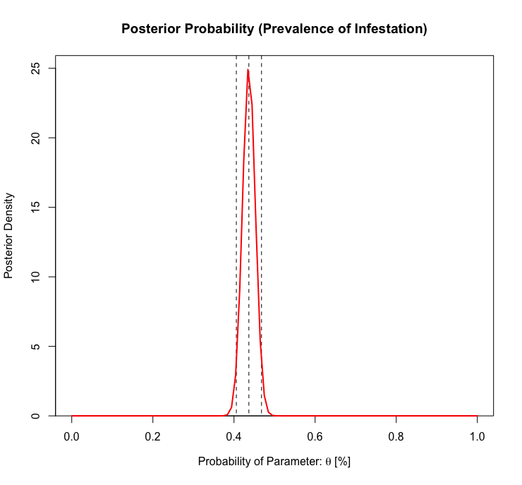
Updated result
$Bin(Total, Prevalence)$ x $Beta\left(Prevalence \right|a − 1, b−1)$
Interpretation:
The predicted prevalence is approximately 44% with 95% credible intervals (40% to 47%)
The most plausible value for prevalence of infestation is 44% because it has a highest degree of plausibility
The credibility limits show the degree of uncertainty around prevalence which could be anywhere between 40-47%
Degree of Plausibility
Predicted prevalence
37

Slide 38
Probabilities
Bayes’ Rule
Bayesian Inference
Probability Functions
38

Slide 39
Any questions?
39

